Slide 1
OIS 6660
Adam Tidwell
12/2/14

Slide 2

Agenda
Quiz
Lecture
Risk Management
Group project
Create Risk Management Plan
Notes:
Agile
plan driven
Fixed – scope
Variable – cost, time
Value driven
Fixed – cost, time
Variable - scope

Slide 3

Quiz 7
On Canvas
25 minutes
Closed book/internet

Slide 4
Lecture
PMBOK
Chapter 11: Project Risk Management

Slide 5
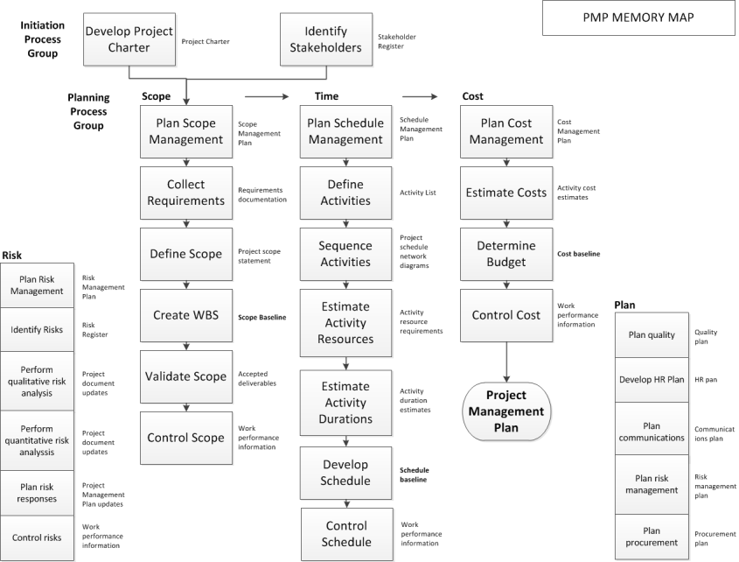

Slide 6
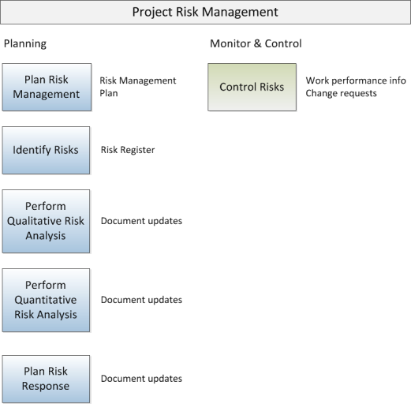
Project Risk Management
Notes:
Plan risk management- The process of defining how to conduct a risk management activities.
Identify risks- The process of determining which risks may affect the project and documenting their characteristics.
Perform qualitative risk analysis- The process of prioritizing risks for further analysis or action by assessing and combining their probability of occurrence and impact.
Perform quantitative risk analysis- The process of numerically analyzing the effect of identified risks on overall project objectives. How much I’m going to loose?
Plan risk responses- The process of developing options and actions to enhance opportunities and to reduce threats to project objectives.
Control risks- The process of implementing risk response plans, tracking identified risks, monitoring residual risks, Identifying new risks, and evaluating risk process effectiveness throughout the project.

Slide 7
Plan Risk Management
How should you plan for risk?
Notes:
Methodology- Defines the approaches, tools, and data sources that will be used to perform risk management on the project.
Roles and responsibilities- Defines the lead, support, and risk management team members for each type of activity In the risk management plan, and clarifies their responsibilities.
Budgeting- Estimates funds needed, based on assigned resources, for inclusion in the cost baseline and estimates protocols for application of contingency and management reserves.
Timing- Defines when and how often the risk management processes will be performed throughout the project lifecycle, Establishes protocols for application of schedule contingency reserves, and establishes risk management activities for inclusion in the project schedule.
Risk categories- Provide a means for grouping potential causes of risk.
Definitions of risk and probability impact- Definition of the levels of Risk probability and impact for the individual project.
Probability and impact matrix- Grid for mapping the probability of each risk occurrence and its impact on project objectives if that risk occurs.
Revised stakeholder tolerances- Stakeholders tolerances for risk as it applies to the specific project.
Reporting formats- How’s the outcome of the risk management process will be documented, analyzed, and communicated.
Tracking- .How risk activities should be recorded

Slide 8
Identify Risks
Brainstorming
Delphi technique
Interviewing
Root cause analysis – Fish Bone, What could go wrong and why?
Notes:
Delphi Technique- A way to reach consensus of experts. Project risk experts participate in this technique anonymously. The facilitator uses a questionnaire to solicit ideas about the important project risks. The Delphi technique helps reduce bias in the data and keeps anyone person from having undue influence of the outcome.
Brainstorming – people activity, discuss each and every idea

Slide 9
Risk Register
List of identified risks
List of potential responses
Source: www.isixsigma.com
Notes:
Risk register- A document in which the results of risk analysis and risk response planning are recorded.
Risks have negative annotations (threats) but there can be positive risks too (opportunities)

Slide 10
Plan Risk Responses
Threats
Avoid
Transfer
Mitigate
Accept
Opportunities
Exploit
Enhance
Share
Accept
Notes:
Avoid- Project team asked to eliminate the threat or protect the project from its impact. It usually involves changing the project management plan to eliminate the threats entirely.
Transfer- Risk response strategy whereby the project team shifts the impact of a threat to a third party, together with the ownership of the response. An example is insurance or warranties.
Mitigate- Project team asked to reduce the probability of occurrence or impact of a risk.
Accept- Project team decides to acknowledge the risk and not take any action unless the risk occurs. Adopted where it is not possible or cost-effective to address a specific risk in any other way. Contingency reserve.
Exploit- Seeks to eliminate the uncertainty associated with particular upside risk by ensuring the opportunity definitely happens. Example, assigning the best people to the project.
Enhance- Increase the probability and for the positive impacts of an opportunity. Identifying and maximizing key drivers of these positive impact risks To increase the probability of occurrence. Example, adding more resources to finish early.
Share- Allocating some or all of the ownership of the opportunity to a third party who is best able to capture the opportunity for the benefit. Example, joint ventures.
Accept- Being willing to take advantage of the opportunity if it arises, but not actively pursuing it.

Slide 11
Perform Qualitative Risk Analysis
Risk probability and impact assessment
Probability and impact matrix
Notes:
Qualitative- Prioritizing risks
Thresholds must be assigned for each organization. Each is unique.
Helps identify significant risk impacts in the project.

Slide 12
Perform Quantitative Risk Analysis
Sensitivity analysis
Expected monetary value analysis
Modeling and simulation (Monte Carlo)
Notes:
Quantitative- Analysis performed on prioritized risks to show the impact of the risk on the project.

Slide 13
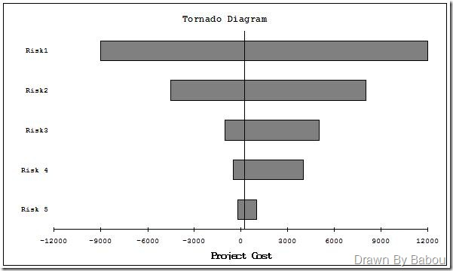
Sensitivity Analysis
Shows which risks have the largest potential impact
Helps identify stable vs. uncertain variables
Flip’s Dynamics Blog http://fichoo.blogspot.com/2012/02/sensivity-analysis.html
Notes:
Sensitivity analysis- Helps determine the largest potential impact on a project. Tornado diagram.
People focus more on first two as their impact both loss and gain are more. Like putting more resources, mitigate or transfer.

Slide 14
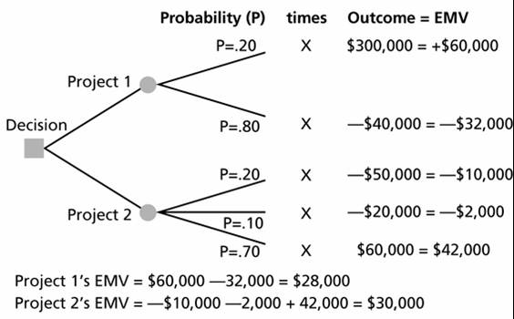
Expected Monetary Value Analysis
Calculates the average outcome when uncertainty exists
Multiply value of each outcome by probability of occurrence
https://www.e-education.psu.edu/geog584/l8_p5.html
Notes:
Expected monetary value analysis- Calculated by multiplying the value of each possible outcome by its probability of occurrence and adding the products together. Decision tree analysis.

Slide 15
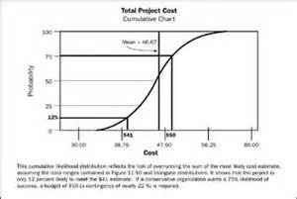
Monte Carlo Technique
Many simulations, using random sampling, to obtain probable results distribution
PMBOK, 5th Edition
Notes:
Monte Carlo Technique- Simulation using computer calculations.

Slide 16
Group Project
Create Risk Management Plan

Slide 17
Risk Management Plan
Create a Risk Register
Include at least 8 risks (threats or opportunities)
Indicate the strategy for addressing each risk (avoid, transfer, exploit, enhance, etc.)
Include the detailed plan for addressing the risk
List the trigger for when the risk response should go into effect

Slide 18
PMP/CAPM Test Prep

Slide 19
Test Prep
Mnemonics for Memory Map
Practice questions

